Slide 1
Math analysis
Day 49

Slide 2
Objective
Install Bricklayer (those that are left)
Code in Bricklayer
Bricklayer Quiz
Organize Documentation
Main Project

Slide 3

Multibrick

Slide 4
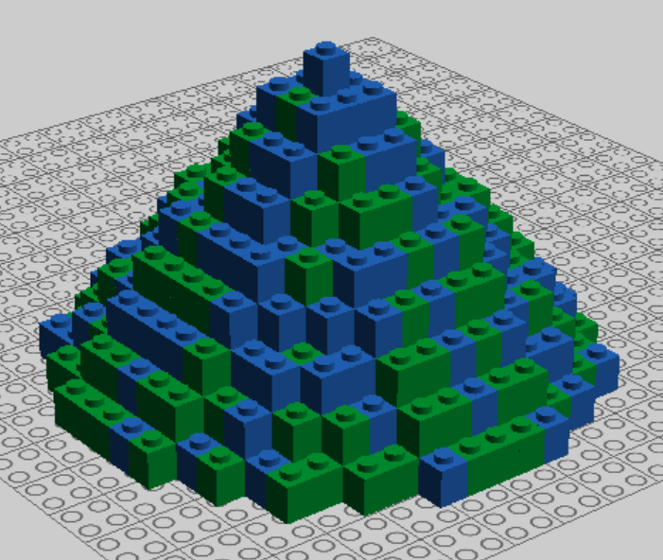
Cone

Slide 5
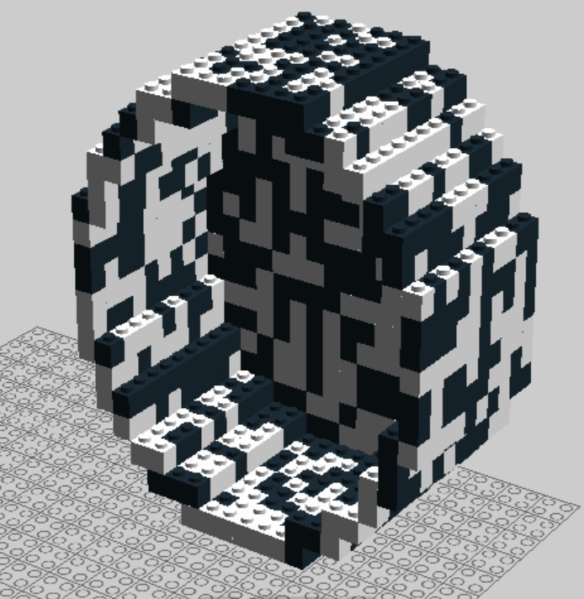
Hollow Cylinder

Slide 6
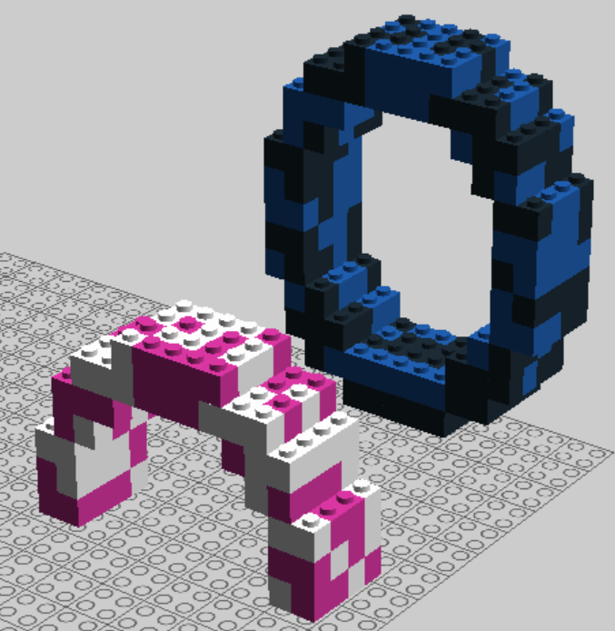
Rings

Slide 7
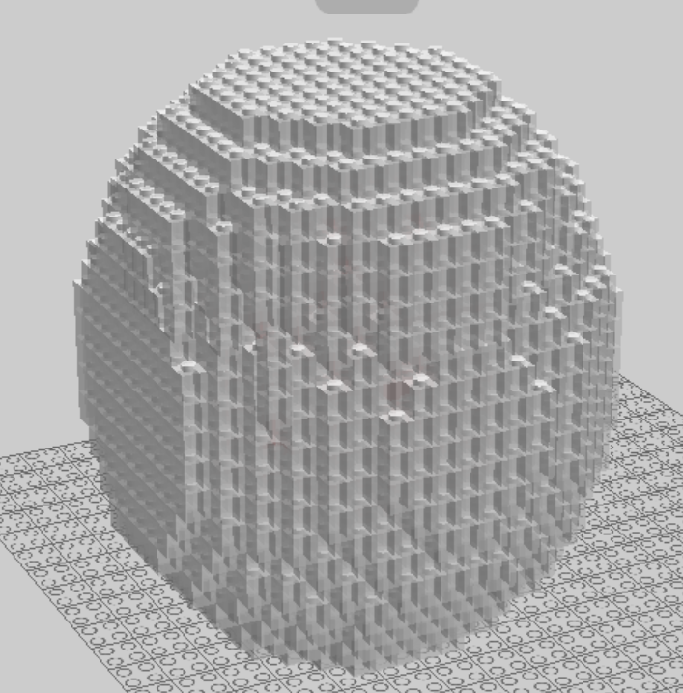
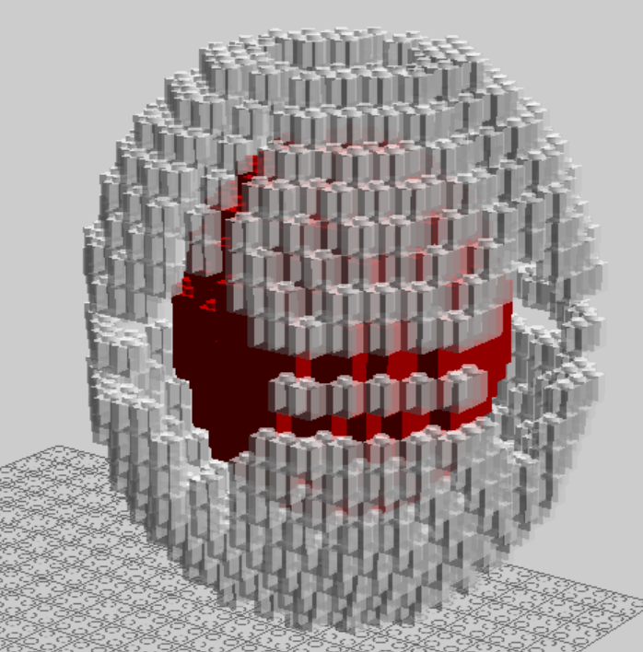
Sphere (hollow with sphere inside)

Slide 8
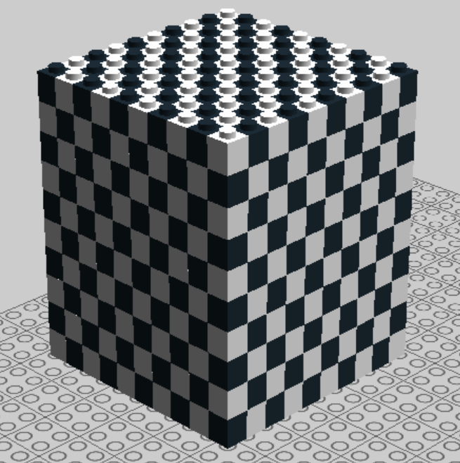
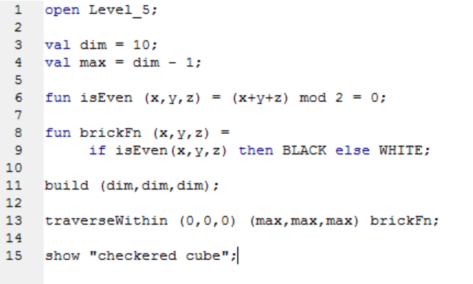
Functions with Variables

Slide 9
More Function Examples in Level 5 Documentation worth exploring…
https://bricklayerdotorg.wordpress.com/level-5-document/

Slide 10
Documentation
Create a file and copy and paste in documentation that you think will be helpful.
Include the link so you can easily find it later.

Slide 11
Major Project Ideas
Bryan High School
Video Games
Stadium
Dream Houes
Town

Slide 12
Major Project Groups
Bryan High School
Emily, Nicole, Fernando, Patrik, Adriana, Edwin
Town
Jakob, Alyssa, Pieter
________

Slide 13
Attempt to Download Bricklayer, Lego Digital Design, and LDraw
Standard Bricklayer Setup
Bricklayer (2016.10.12) - https://bricklayerdotorg.wordpress.com/windows-download/
LEGO Digital Designer - http://ldd.lego.com/en-us/download/
LDraw - http://www.ldraw.org/article/104.html

